Slide 1
Managerial Economics and Financial Analysis
D. MAHESWARI
Assistant Professor
Department of Information Technology
Aditya Engineering College (A)
Email: Maheswari.dama@aec.edu.in

Slide 2
Course Outcomes
At the end of the Course, Student will be able to:
CO 1 :Explain the Managerial Economic concepts for decision making and forward
planning
CO 2 : Illustrate the law of demand and its exceptions by using different
forecasting methods.
CO 3 : Identify the cost behavior for managerial decision making and Break Even
Point (BEP) of an enterprise

Slide 3
Course Outcomes
CO 4 : Classify the different types of business organizations along with basic
knowledge on business cycle.
CO 5 : Make use of the process & principles of accounting for the preparation of
final accounts
CO 6 : Utilize various techniques on investment project proposals with the help of
capital budgeting techniques for decision making

Slide 4
Course Objectives
COB1 :To equip the students with the basic inputs of managerial economics and demand concepts
COB2 :To understand the nature of markets, Methods of Pricing in the different market structures and to know the different forms of Business organization and the concept of Business Cycles
COB3 : To impart the knowledge on production theories, its factors and cost analysis.
COB4 : To make the students take optimal decisions and acquiring the knowledge on financial accounting and its analysis

Slide 5
Course Contents
UNIT I : Introduction to Managerial Economics and
demand Analysis
UNIT II : Production and Cost Analyses
UNIT III: Introduction to Markets, Pricing Policies &
Types of Business Organization and
Business Cycles
UNIT IV: Introduction to Accounting & Financing Analysis
UNIT V : Capital and Capital Budgeting

Slide 6
Text Books
Dr. A. R. Aryasri – Managerial Economics and Financial Analysis, TMH 2011.
Dr. N. Appa Rao, Dr. P. Vijay Kumar: ‘Managerial Economics and Financial Analysis’, Cengage Publications, New Delhi – 2011.
Prof. J.V. Prabhakara rao, Prof. P. Venkatarao. ‘Managerial Economics and Financial Analysis’, Ravindra Publication.

Slide 7
LEARNING OUTCOME
At the end of the This lecture , Student will be able to:
LO 1 :Explain the Managerial Economic concepts for decision making and forward
planning

Slide 8
CONTENTS
Definition of Managerial Economics –Scope of Managerial Economics and its relationship with other subjects –Concept of Demand, Types of Demand, Determinants of Demand- Demand schedule, Demand curve, Law of Demand and its limitations- Elasticity of Demand, Types and Measurement-Demand forecasting and its Methods.

Slide 9
MANAGERIAL ECONOMICS INTRODUCTION
The word Managerial economics is a combination of two words
1.Management
2.Economics

Slide 10
MANAGERIAL ECONOMICS INTRODUCTION
Management
Management is universal in the modern industrial world, and there is no substitute for good management. It makes human efforts more productive and brings technology.
Management is the coordination of all resources through the process of planning , organizing , Directing and controlling in order to attain stated objectives. In simple it is an art of getting things done through the people for achieving organizational objectives.

Slide 11


Slide 12
What is Economics?
Economics
The word Economics is derived from the word Oikonomikos which can be divided into Two parts
Oikos Which means House
Nomos Which means Management
Economists study the economy. In the economy, goods and services are produced, exchanged, and consumed. So, economics is the study of the production, exchange, and consumption of goods and services.
“The study of the allocation of scarce resources among competing and insatiable needs so as to maximize welfare”

Slide 13
Definitions of Economics
Definitions of economics
Wealth definition:
According to Adam Smith “ Economics is the study of wealth, He defines the subject as an enquire of nature and causes of Wealth.
Scarcity definition:
According to Prof Lionnel Robbins “Economics as the science of studies human behaviour as a relationship between end and scarce means which have alternative uses.

Slide 14
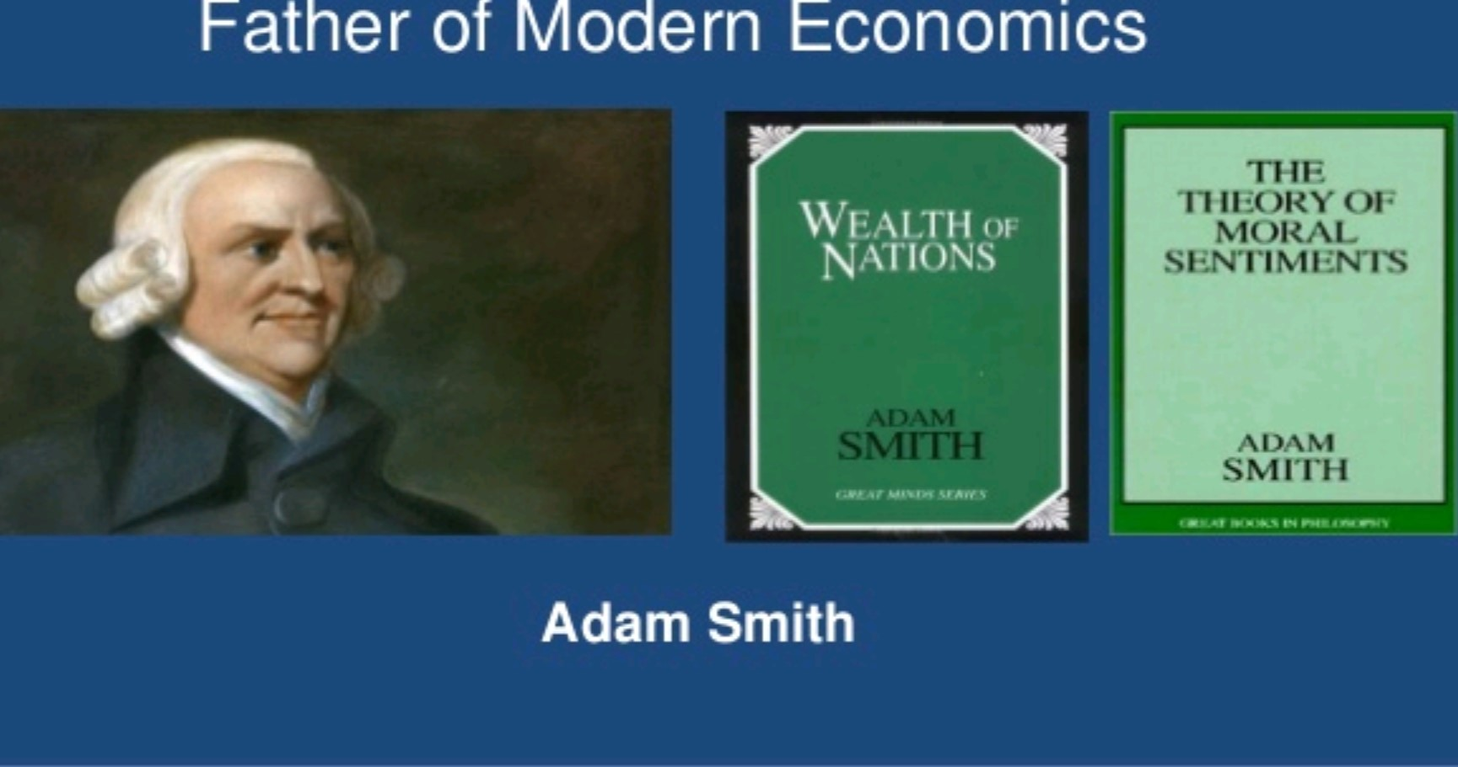

Slide 15
Branches of Economics
1.Micro economics
2.Macroeconomics
Microeconomics looks at the production, exchange, and consumption of goods and services at the level of an individual producer of the good or the market in which a single good or service is exchanged or an individual consumer of the product. The key word is individual; microeconomics deals with the behaviour of the individual entities that make up the economy.
Macroeconomics deals with the entire national economy. Rather than being concerned with the production of a single good or service.

Slide 16
Introduction of Managerial Economics
Managers in their day to day activity are always confronted with several issues Such as
How much quantity is to produce?
Where to produce?
At What price?
Managerial economics provides us a basic inside into seeking the solution for Managerial Problems.

Slide 17


Slide 18
Definitions Of Managerial Economics
Spencer and Siegelman defined Managerial Economics as “ the integration of Economic Theory with Business practice for the purpose of facilitating Decision- Making and Forward Planning by Management”.
Brigham and Pappas believe that Managerial Economics is “ the application of economic theory and methodology to Business administration practice”.

Slide 19
Economics Theory & Methodology
Business Management- Decision problems
Managerial Economics
Application of Economics to solving Business problems
Optimal Solutions to Business Problems

Slide 20
S.No | Micro Economics | Macro Economics
Pricing
Un employment
Gross Domestic Product
Inflation
Cost of the product
Demand of the Product
Supply of the products
Monopoly Markets
Gross Domestic Product

Slide 21
Thank you

